Slide 1
IoT and Computer Vision for Analysing the players on the IISERB Badminton court
Group - PAI
Alli Khadga Jyoth - 19024
Anushka Sanjay Shelke - 19290
Yasmin Manavar Tadavi - 19321

Slide 2
Motivation
Computer vision and IoT is evolving faster in various fields including sport analysis.
As computer vision is used in player detection, tracking etc.
Used by coaches for performance enhancement of team.
This model will be used in IISERB badminton Court for players to analyse their performance.
We are trying to make them accessible to everyone.

Slide 3
Research Gaps
In the paper by T.Kamiyama et al., they used a TLD model for player detection, which is very susceptible to sharp gradients. So, they proposed an image pixel compensation method to solve the problem of player occlusion by the net, which is very common to have for badminton primarily due to the heavy use of monocular cameras used to record the matches. But this method is not perfect, and TLD can incorrectly learn the foreground objects and background objects as lines if they have sharp gradients. Which means it cannot detect the player.
In the paper by Rahmad et al., they added a new local CNN extractor before the feature extraction by the DL model, which considerably increased the accuracy of HIT/NONHIT detection of the shuttlecock. This paper showed that global extraction for features is not efficient.
We aim to use YOLO as our backend for our player detection model and improve feature extraction using the methods proposed by the researchers to make our model lightweight, fast, and accurate.

Slide 4
Problem Definition
We are developing a lightweight player detection and tracking model. Which can run on a raspberry pi, detect, track, and extract information such as Count registered hits /misses, occupancy, players team, players position, etc. All from the live feed of CCTV/camera in the badminton court. Then hosting the data live to a website.

Slide 5
Problem Definition and Contributions
We’ll make an accurate, lightweight model which is easy to run on a raspberry pi. This model will detect, track and also be able to extract features like HIT/NONHIT of shuttlecock, court occupancy, player position, etc...
Make a game classification model classify the sport they are playing. This model will also be helpful for other researchers or projects.
We’ll have a website where one can see and visualize the data.
We’ll try to implement a crowd and fight detection model to alert the relevant authorities if possible. This model is handy in these times.
We hope to implement this setup in our institution, which will provide the badminton players with an easy way to analyze and improve their performance.

Slide 6
Objectives
Make a lightweight model for detection, occupancy and tracking of players.
Make a Image classification model for classification of games.
Make a website to display the processed players’ data.
Possibly developing a model for detecting and predicting fights, if possible.
Real time 3d motion tracking of players and translating to a 3d model, if possible.

Slide 7
Proposed Methodology
Researching and understanding the existing object detection models.
Researching and understanding the models used for player detection and tracking in sports.
Developing and testing an improved model based on previous research for player detection and tracking.
Developing a image classification model for classification of games.
Try to run on a raspberry pi with live footage of a badminton match.
Host the results on a website for people to access.

Slide 8
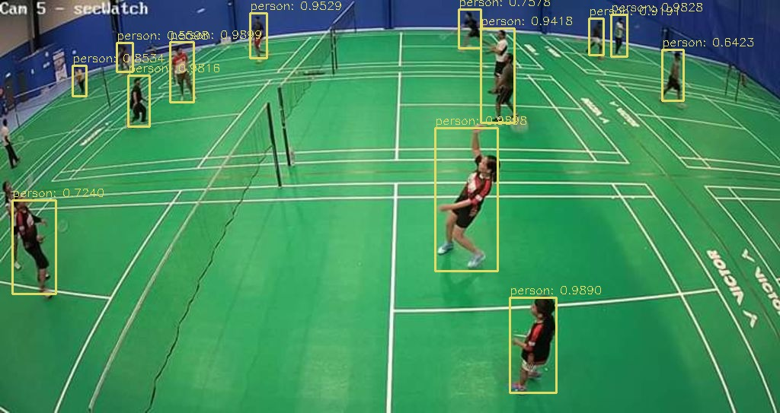
Possible Results
Tracking the players and detect there position.
Count the no of players on the court.
Extracting the relevant data.
Hosting the data on website.
Possibly detecting fights and crowds and alerting relevant authorities.
Possibly Real-time 3D motion tracking of players and retargeting it to a 3D model.
This is a demo of YOLO object detection model, we aim to use in our project.

